Slide 1
Order of Service for the 250th Anniversary of Hugh Bourne’s Birth

Slide 2
Call to Worship:
L: ‘In the last days,’ God says, ‘I will pour out my Spirit upon
all people.
All: Your sons and daughters will prophesy.
Your young men will see visions, and your old men will
dream dreams.
L: Your majesty above the heavens is yet recounted:
All: by the mouths of babes and children.
Hymn StF 106: God, whose almighty word
[No.91 in PM Hymn Book 1862]

Slide 3
Prayers of Adoration and Confession:
Responses:
L: You are God, we thank you. All: You are God, we praise you!
L: God of Love, All: Have mercy upon us.

Slide 4
Collect for Methodist Heritage:
God of the past, the present and the future, we thank you for the way your goodness and beauty, love and mercy, have been declared through the story of your people, called in every generation out of slavery into freedom, called to follow your Son Jesus Christ, called to be witnesses to the ends of the earth in the power of your Spirit, transforming lives today as our forebears transformed lives in times past.

Slide 5
We thank you that in the re-telling of the history of the church, and in the re-discovery of your presence in places of encounter we can engage in bringing buildings and stories to life today as tools for evangelism.
We pray for those who care for those special chapels and churches which seek to be open to visitors, tourists and pilgrims, who come to learn about the history of the people called Methodists.

Slide 6
Especially we pray for the work of Englesea Brook Chapel and Museum, as it celebrates the Primitive Methodist tradition within the life of our Church.
We pray for curators and heritage and learning officers, volunteer guides and helpers, and all trustees of historic chapels.

Slide 7
We pray for all churches seeking to make sense of the past especially those seeking to connect, through our Methodist Heritage and Contemporary Mission, to many people living, working and visiting our villages, towns and cities, the story of your abiding love for us in every generation, that we might be alive to the challenge of God’s mission today and the work we must do for the future.
We ask these things through the name of Jesus Christ our Lord and Saviour, Amen

Slide 8
Introduction to Hugh Bourne and Primitive Methodism:
Monologue available to download at www.engleseabrook.org.uk

Slide 9
Hymn by Andrew Pratt (tune Regent Square)
We will join in celebration
of the line in which we stand,
grown beyond imagination,
grace for all throughout the land:
sisters, brothers, (sisters, brothers),
here in union, hand in hand.

Slide 10
Once a man who followed Jesus had a vision for the earth, grace and joy for all the people freed from poverty from birth: sing the story, (sing the story), sing in knowledge of our worth.

Slide 11
From a farm to work and fireside he would preach and work and act living out the gospel message, turning words to living fact, still we’re learning, (still we’re learning), letting love and faith attract.

Slide 12
Now in grace and hope and friendship we will stand on solid ground, we will follow in the footsteps, of the Christ, Hugh Bourne had found, onward pilgrims, (onward pilgrims), let our song of joy resound!
Andrew Pratt © Copyright 2022 Stainer & Bell Ltd, London, www.stainer.co.uk. Used by permission. All rights reserved

Slide 13
Suggested Readings
Genesis 28 Jacob at Bethel
Acts 16 : 11-15 She [Lydia] was baptized and her household with her
John 1: 43-51 Can anything good come out of Nazareth?
Hymn StF 401: “Come, sinners, to the gospel feast” [No.213 in PM Hymn Book 1862]

Slide 14
Sermon: Unlikely Saints
See Sermon suggestions on the website: www.engleseabrook.org.uk

Slide 15
Hymn by Andrew Pratt (tune: The Streets of Laredo)
1. From farm-yard to fireside this carpenter, preacher set free by the gospel sang praise in the hills, like Jesus, the poor were his constant companions, from factory or workhouse, from slum house or mills.
2. The good news was more than a spiritual compass, he broke from the ones who were buttressed by wealth, he shattered the barriers of class and distinction and sought for equality, freedom and health.

Slide 16
3. He read to the heart of the scripture he studied, envisaged a commonwealth founded on grace, where all of the people were one with each other, who sought to see Jesus in everyone’s face.
4. He offered redemption to all who would hear him, not bounded by buildings, conditions or rules, the people were warmed by his kind invitation, though some criticised them, and some called them fools.

Slide 17
5. A primitive gospel was all that was needed to lift them above, build up hope, banish shame, that simple perspective will rest with God’s people, who humbly still follow in Jesus’s name.
Andrew Pratt © Copyright 2022 Stainer & Bell Ltd, London, www.stainer.co.uk. Used by permission. All rights reserved

Slide 18
Prayers of Intercession
The Lord’s Prayer
Collection and Dedication
Hymn StF 412: “See how great a flame aspires”
[No. 603 in the PM Hymn Book 1862]

Slide 19
Final Prayer
Almighty God, you raised up your servants, John and Charles Wesley, Hugh Bourne and William Clowes, and all other founding mothers and fathers in faith in the Methodist tradition, to proclaim anew the gift of redemption and the life of holiness.
Pour out your Spirit and revive your work among us; that inspired by the same faith and upheld by the same grace in word and sacrament, we and all your children may be made one in the unity of your Church on earth, even as in heaven we are made one in you; through Jesus Christ our Lord. Amen.

Slide 20
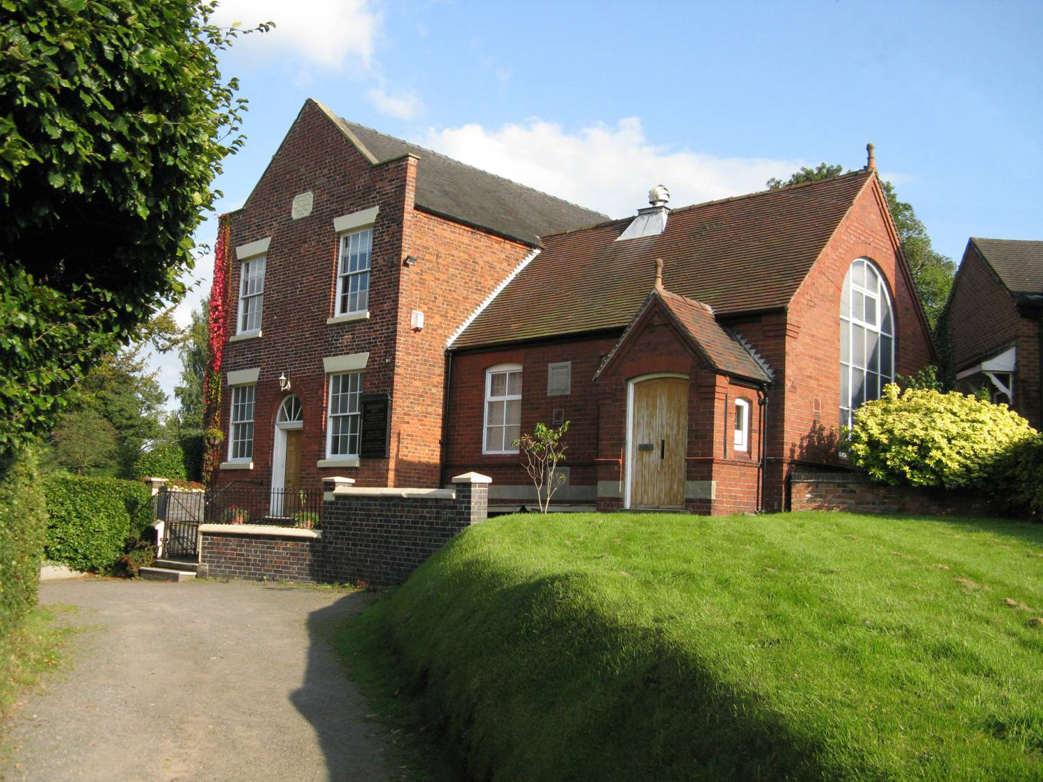
Englesea Brook Chapel and Museum of Primitive Methodism is on the border of Cheshire and Staffordshire and we are here to support you and your church in mission.
Take a look at our website for new opportunities for church and community groups to visit for ‘Space to Be’ away days and day retreats.
www.engleseabrook.org.uk
We look forward to welcoming you

